Slide 1

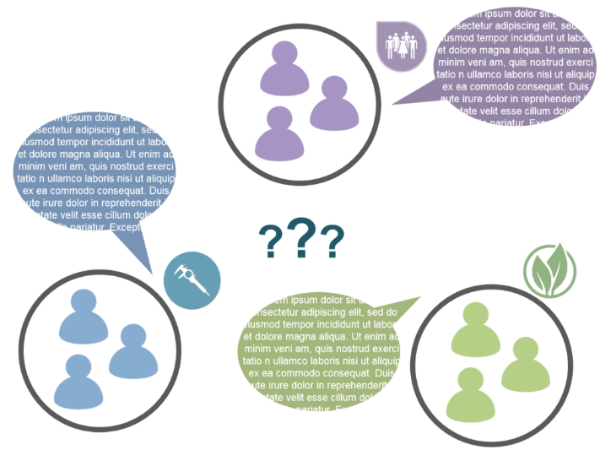
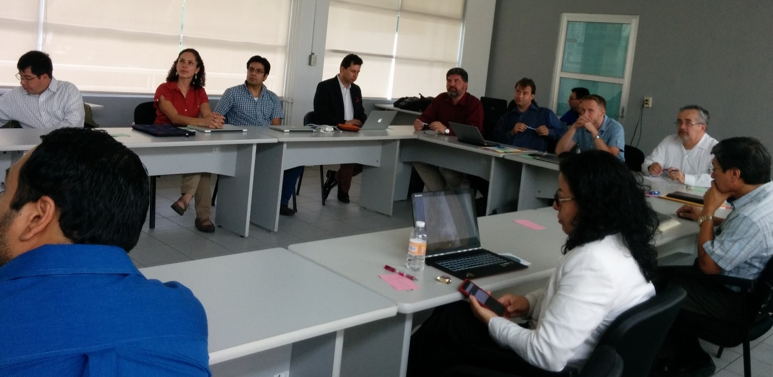
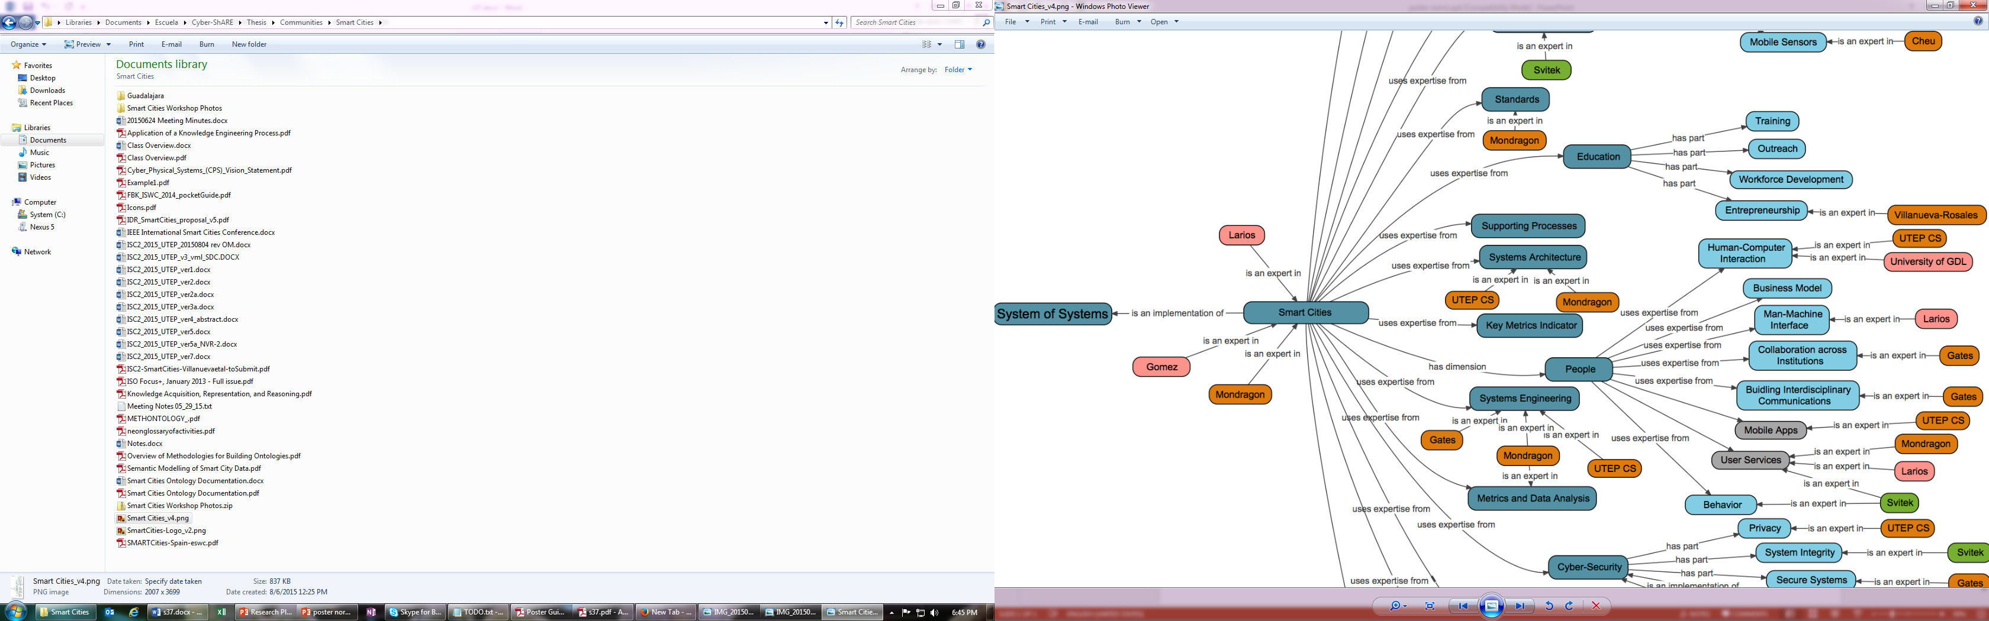
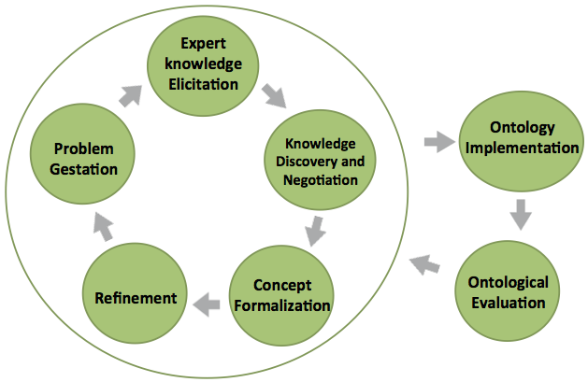

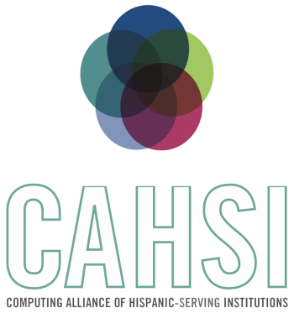


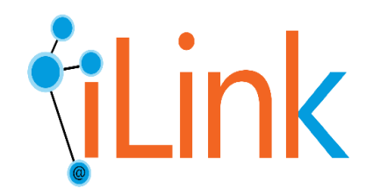
CYBER-ShARE Center of Excellence
Sharing Resources to Advance Research and Education through Cyber-infrastructure
Towards an Ontology Development Methodology for Interdisciplinary
Researh Group Collaborations
Norma Rivera^{1,2}, Natalia Villanueva-Rosales^{1,2,*},Deana Pennington^{2,3,*}, Ann Gates^{1,2,*}
¹Department of Computer Science, ²Cyber-ShARE Center of Excellence, ³Department of Geological Sciences, *Faculty Mentor
nrivera3@miners.utep.edu, {nvillanuevarosales, dpennington, agates} @utep.edu
The University of Texas at El Paso
Abstract
Interdisciplinary research (IDR) collaboration can be defined as the process of integrating experts’ knowledge, perspectives, and resources to advance scientific discovery. These collaborations, however, introduce a new set of “culture” barriers as participating experts are trained to communicate in discipline-specific languages, theories and research practices. We propose that building a common knowledge base using ontologies can provide a starting point for interdisciplinary knowledge exchange, negotiation, and integration. This paper introduces a methodology that extends previous work in collaborative ontology development, and integrates learning strategies, such as concept maps, to enhance interdisciplinary research practices.
Introduction
Methodology
Future Work
Collaborative work in an interdisciplinary setting introduces a different set of “cultural” barriers [1,2]. We address the challenges that come from integrating disparate disciplinary
Our approach extends previous work by developing well-defined solutions to support the inherent learning process.
1. Problem Gestation. Explicitly state (and annotate) the scope and goals to enable envisioning the purpose and design outcomes of the initial ontology.
2. Expert Knowledge Elicitation. Participants separate into smaller groups to define relevant concepts and their relationships.
3. Knowledge Discovery and Negotiation. Clusters of terms are created. This process yields a common vocabulary, visually represented as a draft concept map[8].
4. Concept Formalization. Classes and properties in the ontology are created by mapping concepts and relationships. Data already identified in the previous steps is mapped into instances of the ontology.
5. Refinement. Develop use cases and extend or modify the ontology.
Explore the advantages and limitations of ontologies to represent individual and shared mental models.
Explore the translation of mental models (researcher’s knowledge) to formal models (domain ontologies.
Investigate and evaluate how these interdisciplinary ontologies facilitate data integration and/or analyses to answer specific scientific questions defined by IDR team.
Conclude research work with a wider variety of IDR groups.
perspectives using semantic data models and processes, and incorporating learning theories to support both information exchange and acquisition. Our hypothesis is that by combining semantic methods (e.g. ontology development) with learning practices (e.g. concept map development) we can facilitate the knowledge negotiation process in IDR teams [3,4,9].
Figure 2. Smart Cities group collaboration in GDL.
Conclusions
Background
Preliminary results indicate that the use of conceptual maps has facilitated communication across team members.
Shared understanding across disciplines and knowledge negotiation is a necessary precursor to development of formal ontologies and collaborative work.
Methodologies such as the one proposed here can aid to overcome the barriers found in IDR group settings.
Ontologies are used to explicitly specify a shared conceptualization of a domain in the world [6]. Knowledge represented in ontologies can later be shared and reused among scientists with common research interests to provide formal logics and automated reasoning to support decision-making, data integration, and question answering for future collaborations [5].
References
[1] T. E. Hall, M. O’Rourke, K. Huutoniemi, and P. Tapio, Responding to
communication challenges in transdisciplinary sustainability science. .
Routledge: Oxford, UK, 2014.
[2] National Research Council, Enhancing the Effectiveness of Team Science.
Washington, D.C.: The National Academies Press, 2015.
[3] D. D. Pennington, “The dynamics of material artifacts in collaborative
research teams,” Comput. Support. Coop. Work CSCW, vol. 19, no. 2, pp.
175–199, 2010.
[4] D. D. Pennington, “Collaborative, cross-disciplinary learning and co-
emergent innovation in eScience teams,” Earth Sci. Inform., vol. 4, no. 2,
pp. 55–68, 2011.
5] T. R. Gruber, “A translation approach to portable ontology specifications,”
Knowl. Acquis., vol. 5, no. 2, pp. 199–220, 1993.
[6] L. Tsui, S. A. Chapman, L. Schnirer, and S. Stewart, A Handbook on
Knowledge Sharing: Strategies and Recommendations for Researchers,
Policy Makers and Service Providers. Community-University Partnership
for the Study of Children, Youth, and Families Edmonton, 2006.
[7] R. L. Oxford, “Cooperative learning, collaborative learning, and interaction:
Three communicative strands in the language classroom,” Mod. Lang. J.,
vol. 81, no. 4, pp. 443–456, 1997.
[8] J. Novak and M. Wurst, “Collaborative knowledge visualization for cross-
community learning,” in Knowledge and Information Visualization,
Springer, 2005, pp. 95–116.
[9] D. D. Pennington, “Bridging the disciplinary divide: Co-creating research
ideas in escience teams,” Comput. Support. Coop. Work CSCW, vol. 20,
no. 3, pp. 165–196, 2011.
Figure 1. Sample of concept map developed with Smart Cities group.
The types of interactions proposed in this methodology use efficient collaborative learning strategies [6,7] that include: scaffolding, externalizing self-reasoning, explaining and justifying opinions, among others. This is accomplished by conducting a series of workshops with the team, where participants engage in structured tasks to externalize, share, and discuss their knowledge in ways purposely designed to incorporate the above learning strategies.
Figure 2. Summary of methodology as a highly iterative process. Stages with more IDR group participation enclosed in circle.
This work used resources from the Cyber-ShARE Center of Excellence and the Computing Alliance of Hispanic Serving Institutions (CAHSI), which are supported by National Science Foundation, grant numbers HRD-0734825 and CNS-1042341 respectively. Special thanks to the iLink research group members for their support in this work.
Cyber-ShARE
Linking knowledge across disciplines,
data and models

